Slide 1

Use of causal inference methods in case-control studies
Miceline Mésidor, Institut national de la recherche scientifique, Canada
Alex Keil, National Cancer Institute, USA
December 3, 2025

Slide 2
ConflictS of interest
NONE

Slide 3
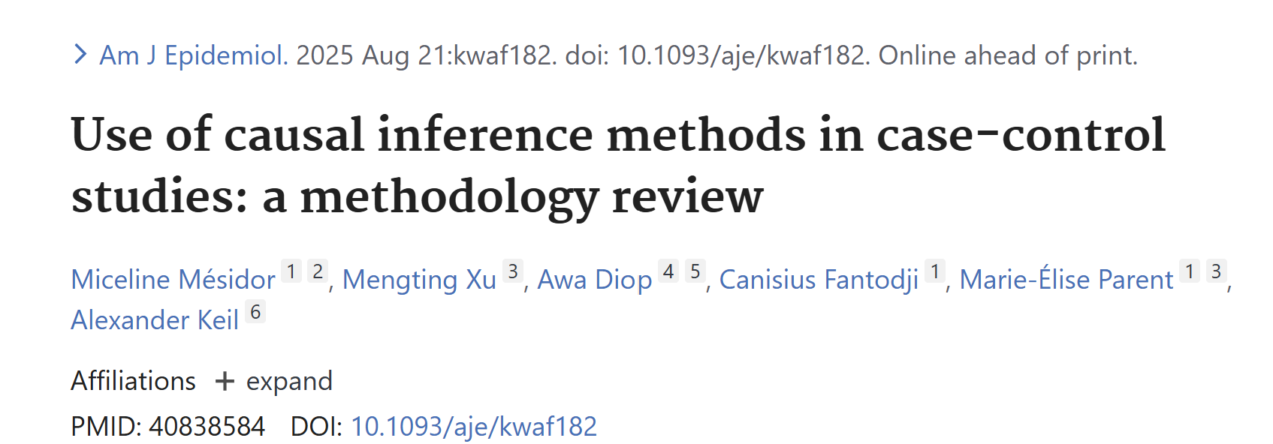
Acknowledgement

Slide 4

Plan
Motivation
Brief introduction of case-control studies
Review of potential outcomes framework in causal inference
Contrast of methods used in cohort vs case-control studies
R codes
Challenges & Conclusion

Slide 5

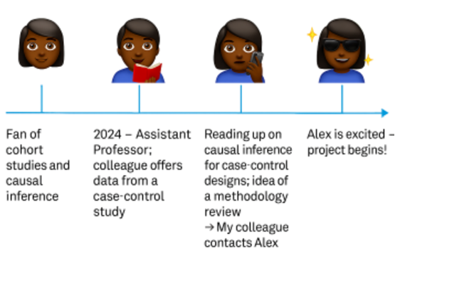
Motivation
Credit image : Copilot

Slide 6
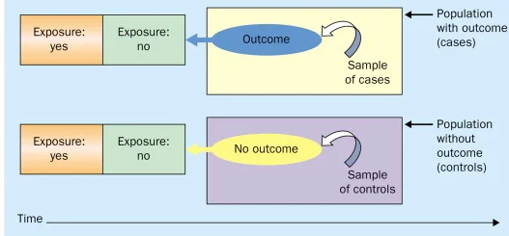
Introduction: case control studies
https://www.simplypsychology.org/case-control-study.html

Slide 7
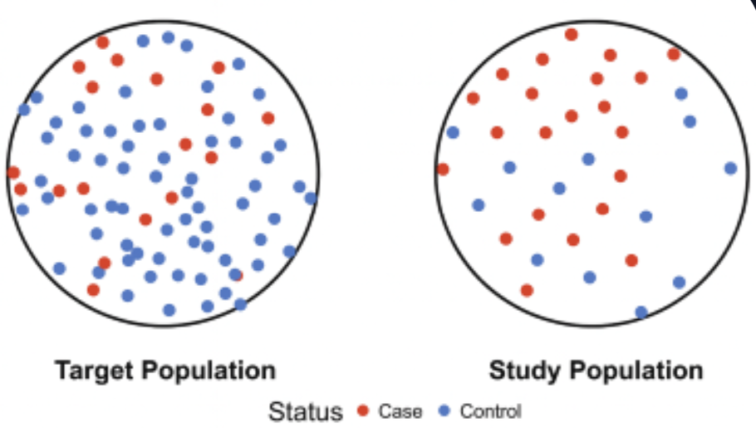
Introduction: case-control studies
Controls are under-sampled from the target population relative to cases
    Outcome sampling bias: prevalence in the study population is high relative to the target population

Slide 8
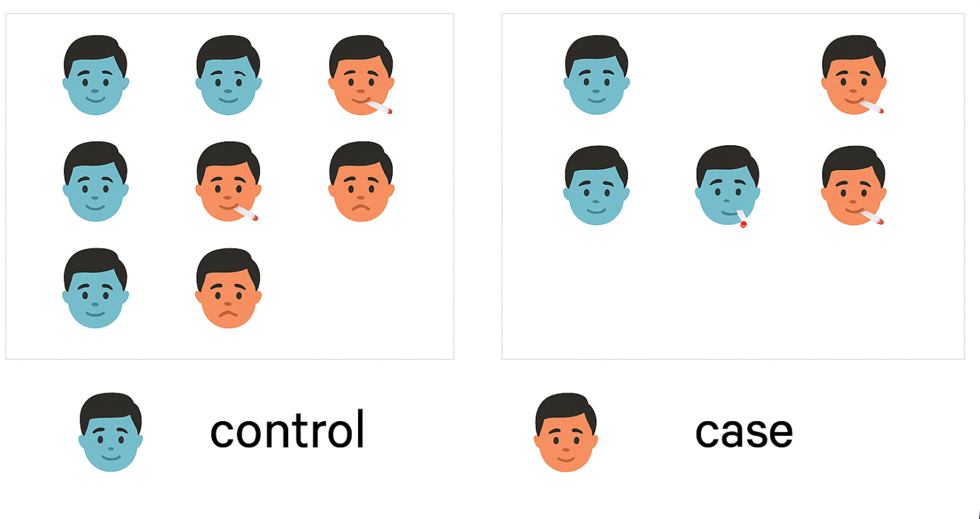
Introduction: case-control studies
Controls are under-sampled from the target population relative to cases
Target population Study sample
    Covariate sampling bias: different distributions of the covariates associated with the outcome in the study population relative to the target population
Credit image : Copilot

Slide 9
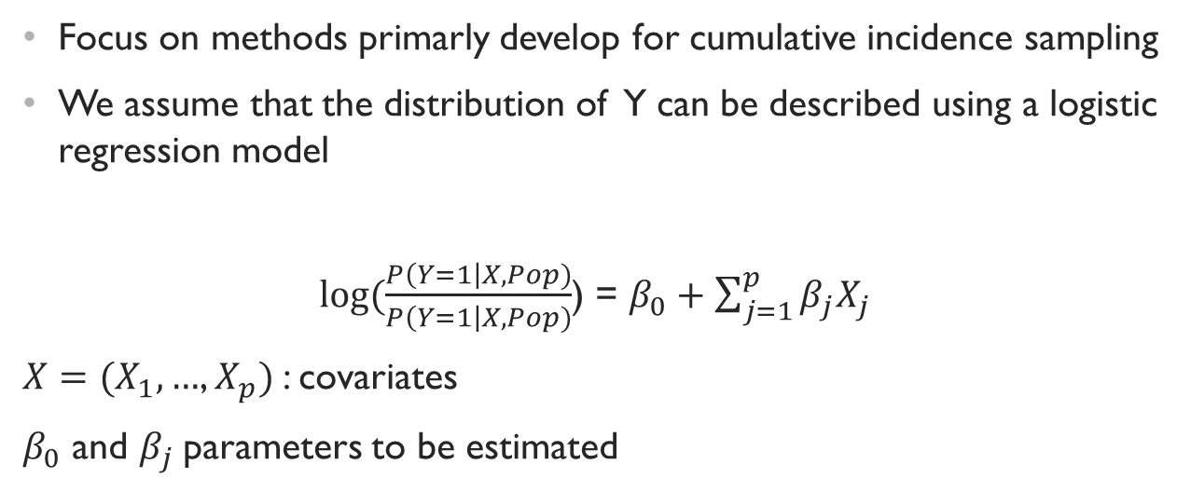
Introduction : our focus
Focus on methods primarly develop for cumulative incidence sampling
We assume that the distribution of Y can be described using a logistic regression model
$\log{(\frac{P\left(Y=1\right|X, Pop)}{P\left(Y=1\right|X, Pop)}}$) = $β_{0}+\sum_{j=1}^{p}{β_{j}X_{j}}$
$X=(X_{1},…$, $X_{p})$: covariates
$β_{0}$ and $β_{j}$parameters to be estimated

Slide 10
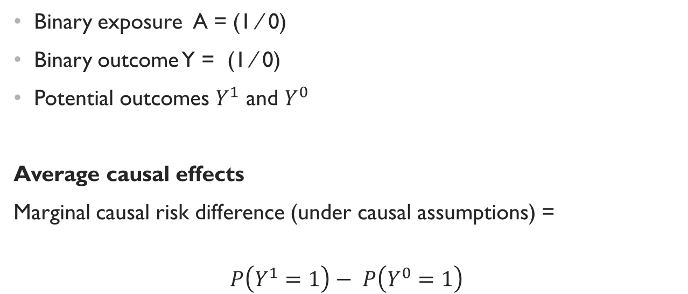
Review of potential outcome framework
Binary exposure A = (1 ⁄ 0)
Binary outcome Y = (1 ⁄ 0)
Potential outcomes $Y^{1}$ and $Y^{0}$
Average causal effects
Marginal causal risk difference (under causal assumptions) =
$$P\left(Y^{1}=1\right)− P\left(Y^{0}=1\right)$$

Slide 11
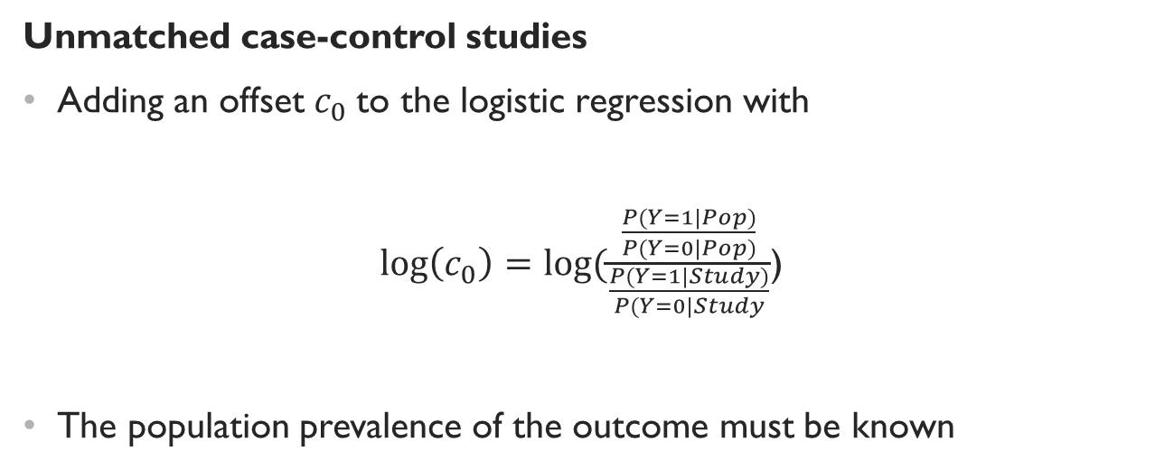
Intercept-adjusted logistic regression
Unmatched case-control studies
Adding an offset $c_{0}$to the logistic regression with
$\log\left(c_{0}\right)=log⁡(\frac{\frac{P(Y=1|Pop)}{P(Y=0|Pop)}}{\frac{P(Y=1|Study)}{P(Y=0|Study}}$)
The population prevalence of the outcome must be known
Greenland, 1981

Slide 12
Intercept-adjusted logistic regression
Matching case-control studies
The offset will be calculated within the matching category => using stratum-specific sampling ORs
Greenland, 1981

Slide 13
Intercept-adjusted logistic regression
Strengths
Simply to use (but rarely used in practice)
Limitations
Conditional causal OR -- for marginal effects in the target population: use of weighting or standardization
Biased under misspecified models

Slide 14

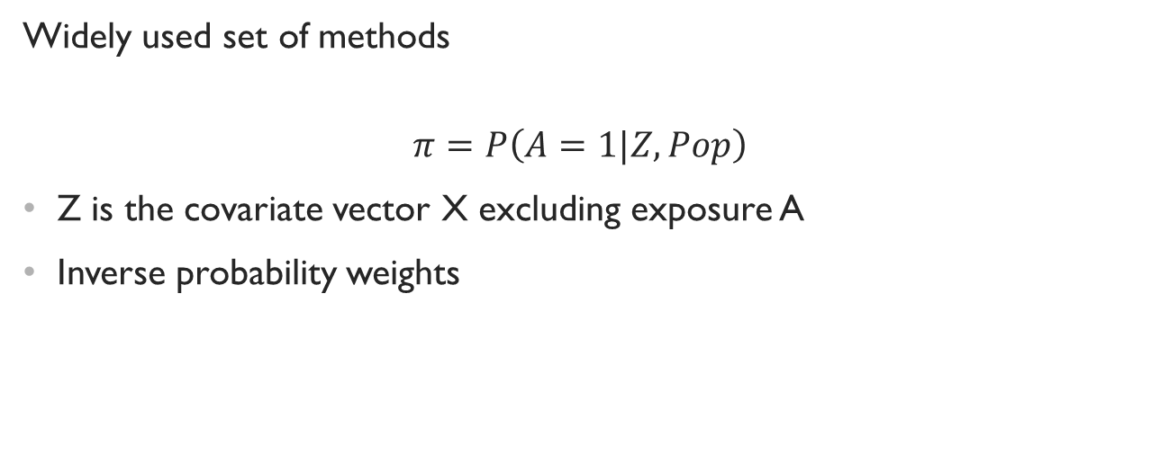
Propensity scores
Widely used set of methods
$$π=P\left(A=1|Z, Pop\right)$$
Z is the covariate vector X excluding exposure A
Inverse probability weights

Slide 15
Propensity scores: Case-control studies
If the exposure increases the probability of the outcome, given Z, exposed individuals will be more common in the case-control study relative to the cohort study.
Biased

Slide 16
Propensity scores: Case-control studies
Robins
Estimation of the propensity score among controls
Application of the weights to all individuals
Mansson
Estimation of the propensity scores in a subset included all controls and a subset of cases
including case status in the propensity score model and estimating propensity scores for all individuals as though they had been controls
Robins 1999; Mansson 2007

Slide 17
Propensity scores: Case-control studies
Zhu
Estimation of the propensity score among cases
Match controls on the predicted propensity scores
Zhu et al., 2019

Slide 18
Propensity scores: Case-control studies
Strengths
Easy to use
Limitations
Biased under incorrect model specification
Sensitive to the positivity assumption
Can estimate only marginal OR
Zhu’s approach: does not yield valid estimates of any marginal parameter

Slide 19
G-computation
Modelling and predicting outcomes under different exposure conditions
1) Regress the exposure and the covariates on the outcome;
2) Using the regression model, predict outcomes for individuals under each exposure condition;
3) Estimate average causal effects by averaging the predicted outcomes across the study population.

Slide 20
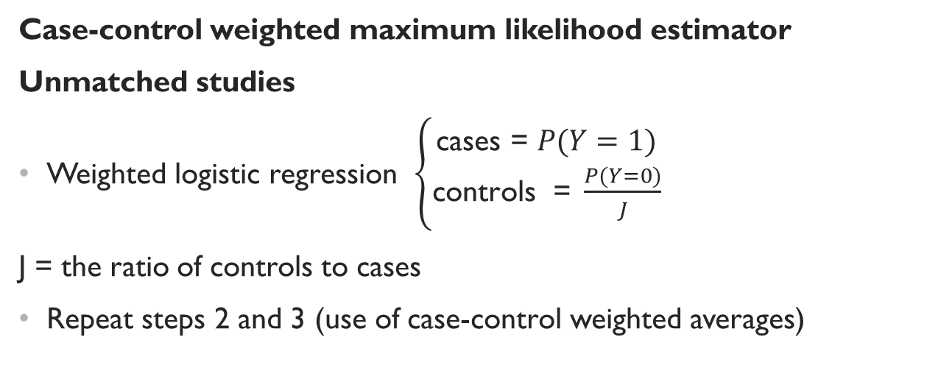
G-computation: case-control
Case-control weighted maximum likelihood estimator
Unmatched studies
Weighted logistic regression $\left\{\begin{aligned}\text{cases}\text{ = }P(Y=1) \\ \text{controls}\text{ = }\frac{P(Y=0)}{J}\end{aligned}\right.$
J = the ratio of controls to cases
Repeat steps 2 and 3 (use of case-control weighted averages)
Rose 2009 ; Rose 2014; Persson 2017

Slide 21
G-computation: case-control
Strengths
Easy to use
Address outcome and covariate sampling
Estimation of marginal effects (OR, RR, and RD)
Limitations
Sensitive to outcome model-specification

Slide 22
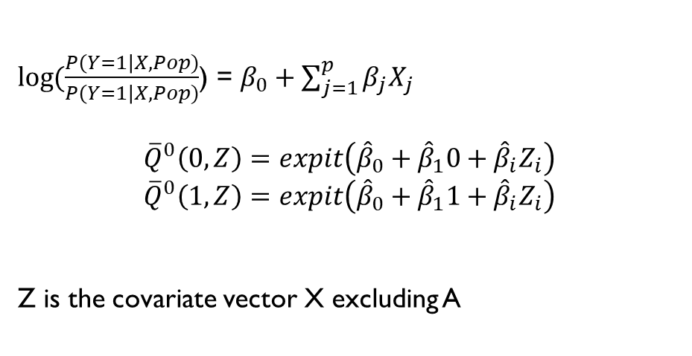
Targeted maximum likelihood estimation
Doubly-robust
$\log{(\frac{P\left(Y=1\right|X, Pop)}{P\left(Y=1\right|X, Pop)}}$) = $β_{0}+\sum_{j=1}^{p}{β_{j}X_{j}}$
$${\overline{Q}}^{0}\left(0, Z\right)=expit\left({\hat{β}}_{0}+{\hat{β}}_{1}0+{\hat{β}}_{i}Z_{i}\right)$$
$${\overline{Q}}^{0}\left(1, Z\right)=expit\left({\hat{β}}_{0}+{\hat{β}}_{1}1+{\hat{β}}_{i}Z_{i}\right)$$
Z is the covariate vector X excluding A
Prediction of the outcome model

Slide 23
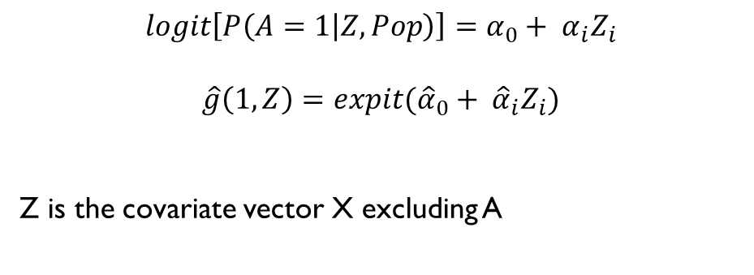
Targeted maximum likelihood estimation
Doubly-robust
$$logit\left[P\left(A=1 | Z, Pop\right)\right]=α_{0}+ α_{i}Z_{i}$$
$$\hat{g}\left(1, Z\right)=expit({\hat{α}}_{0}+ {\hat{α}}_{i}Z_{i})$$
Z is the covariate vector X excluding A
Prediction of the propensity score

Slide 24

Targeted maximum likelihood estimation
Doubly-robust
$$H\left(1, Z\right)= \frac{A}{\hat{g}(1, Z)}$$
$$H\left(0, Z\right)= \frac{1−A}{\hat{g}(0, Z)}$$
Use of the propensity scores to calculate the clever covariates

Slide 25
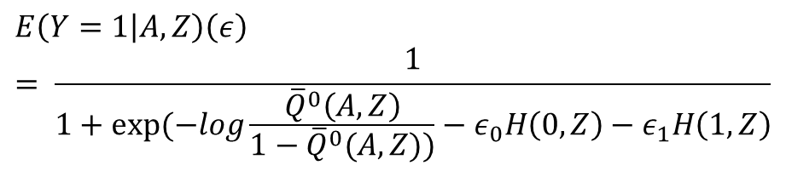
Targeted maximum likelihood estimation
Doubly-robust
$$E\left(Y=1 | A, Z\right)\left(ε\right)= \frac{1}{1+exp⁡(−log\frac{{\overline{Q}}^{0}\left(A,Z\right)}{1−{\overline{Q}}^{0}(A,Z))}−ε_{0}H\left(0,Z\right)−ε_{1}H\left(1,Z\right)}$$
Estimation of the fluctuation parameter

Slide 26
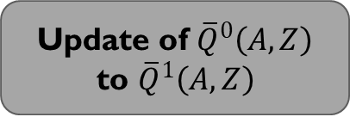
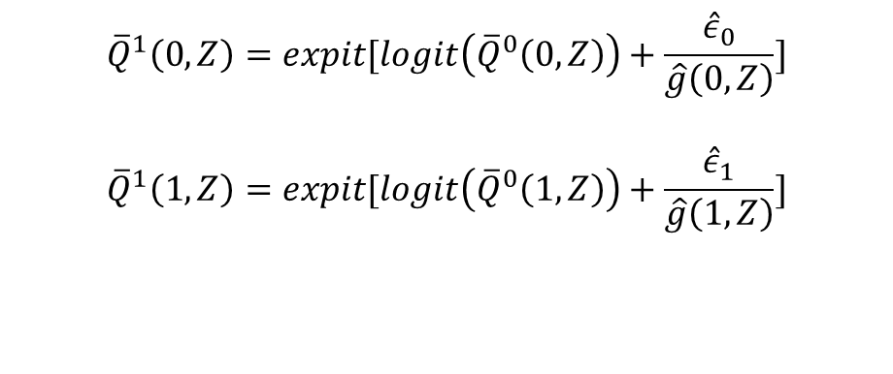
Targeted maximum likelihood estimation
Doubly-robust
$${\overline{Q}}^{1}\left(0, Z\right)=expit[logit\left({\overline{Q}}^{0}\left(0, Z\right)\right)+\frac{{\hat{ε}}_{0}}{\hat{g}\left(0,Z\right)}]$$
$${\overline{Q}}^{1}\left(1, Z\right)=expit[logit\left({\overline{Q}}^{0}\left(1, Z\right)\right)+\frac{{\hat{ε}}_{1}}{\hat{g}\left(1,Z\right)}]$$
Update of ${\overline{Q}}^{0}\left(A,Z\right)$ to ${\overline{Q}}^{1}\left(A,Z\right)$

Slide 27
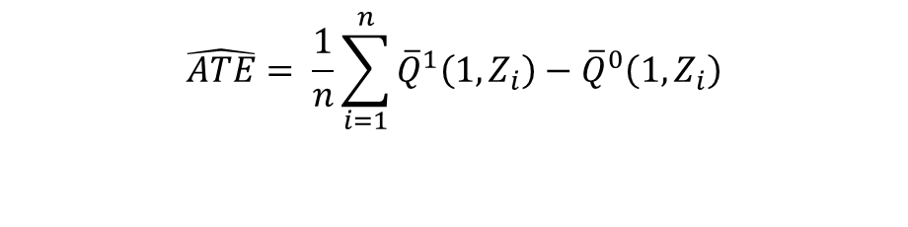
Targeted maximum likelihood estimation
Doubly-robust
$$\hat{ATE}= \frac{1}{n}\sum_{i=1}^{n}{{\overline{Q}}^{1}\left(1,Z_{i}\right)−{\overline{Q}}^{0}\left(1,Z_{i}\right)}$$
Targeted estimate

Slide 28
THANK YOU

